Slide 1
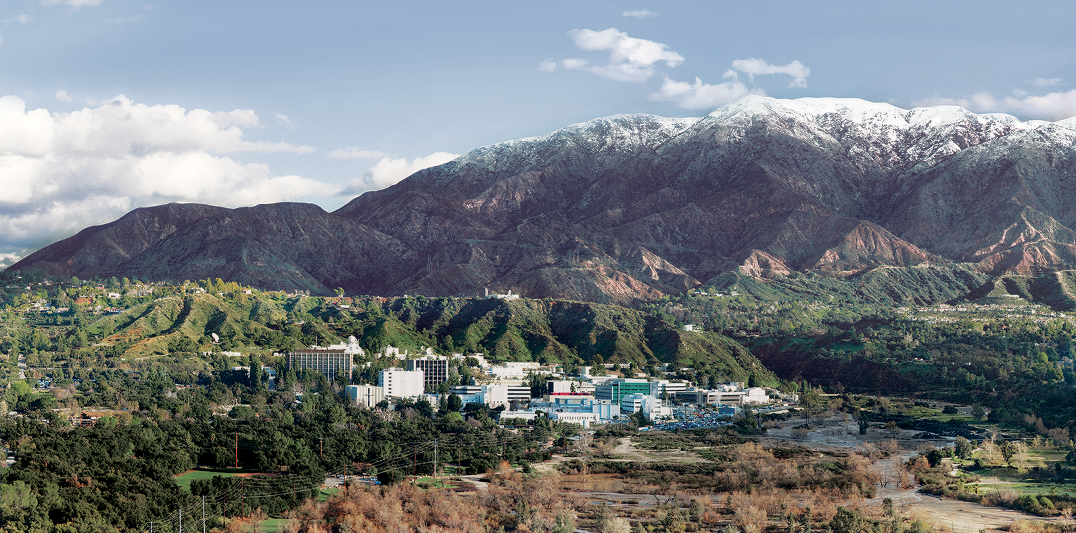
8. Radiances
Dr. David R. Thompson
Jet Propulsion Laboratory, Imaging Spectroscopy Group

Slide 2
Goals for this module
Describe factors affecting the physical measurement of radiance spectra
Interpret and apply calibration data to uncalibrated spectral data cubes
Validate radiances in remote field data using in-situ measurements

Slide 3
Reprise
There are two basic types of imaging spectroscopy data in Earth surface studies.
Transforming from raw instrument values to physical units of radiance is the process of calibration.
Later, we’ll describe the process of estimating surface reflectance from radiance data. This second step is atmospheric correction.
Then, one can use the reflectance spectrum to measure chemical and physical properties of the surface.

Slide 4
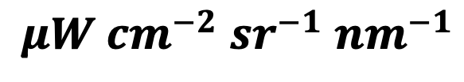
What is the spectral radiance?
$$μW {cm}^{−2} {sr}^{−1} {nm}^{−1}$$
Per unit wavelength interval
Spectral radiance is the radiant flux that is emitted or received by a surface, per unit solid angle per unit projected area per unit wavelength interval.
For observations of an extended homogeneous surface, radiance is independent of distance.
Per unit solid angle
For observations of an extended Lambertian surface, radiance is independent of viewing angle.
Per unit area

Slide 5
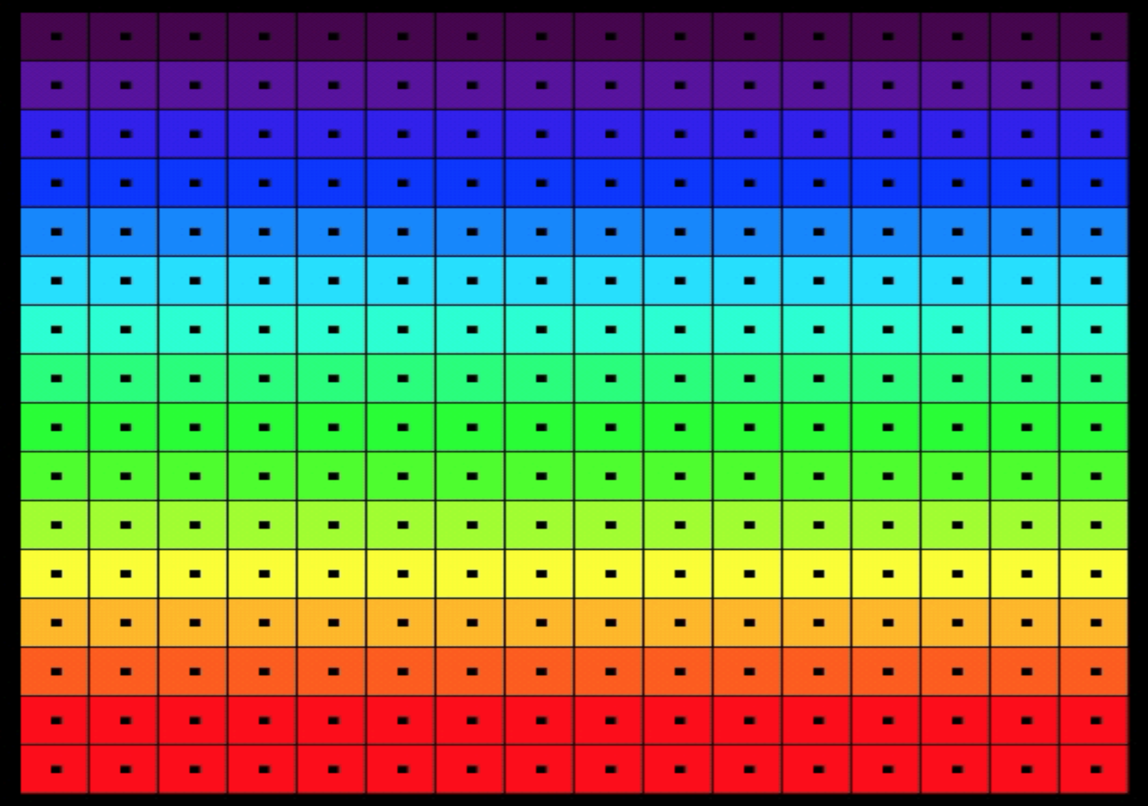
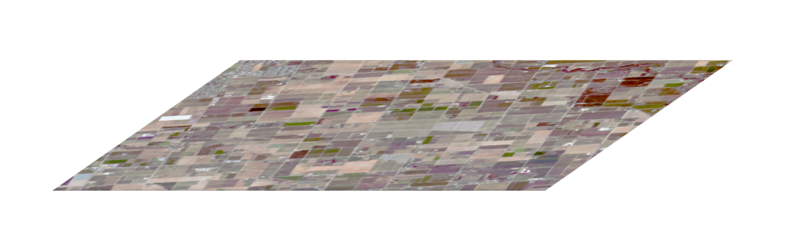
Calibration Conventions
The detector is a two-dimensional focal plane array (FPA). In a typical “pushbroom” design, one is the spatial dimension and the other is the spectral (wavelength) dimension.
To get the second spatial dimension, we ”push” the sensor on a mobile platform.
FPA
Spectrometer
Slit
Telescope
Rows (spectral channels)
Samples (cross-track locations)

Slide 6
Calibration: basic steps
Typically, calibration involves a series of transformations and corrections that “work backwards from the focal plane”
Account for electronic effects - the unique, time-dependent radiometric response of each FPA element
Account for optical effects - the spatial and spectral “view” of each FPA element
Tie to the S.I. (absolute spectroradiometry)
FPA
Spectrometer
Slit
Telescope

Slide 7
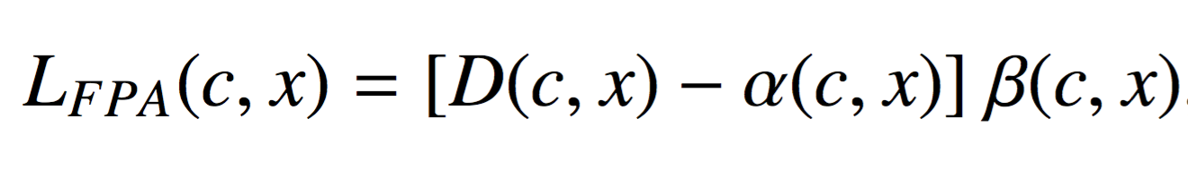
Basic radiometric model
The FPA response is usually linear in illumination. For each crosstrack element x and spectral channel c:
Radiance at FPA
uW nm⁻¹ sr⁻¹ cm⁻²
FPA Value
DN
Offset
DN
Gain
uW nm⁻¹ sr⁻¹ cm⁻² DN⁻¹

Slide 8
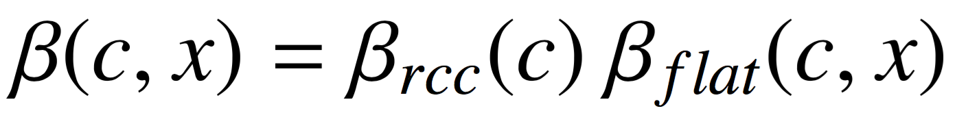
Basic radiometric model
The FPA response is usually linear in illumination. For each crosstrack element x and spectral channel c:
This decomposes into different physical effects:
Offset
DN
Gain
uW nm⁻¹ sr⁻¹ cm⁻² DN⁻¹
Dark Level
(per element, each flightline)
Radiometric Coefficient
(per channel, each campaign)
Flat field
(per element, each campaign)

Slide 9
Components of gain
Estimate RCCs using a NIST-calibrated source
Gain is typically separated into two components. A flat field represents the relative response of all elements on the focal plane array. It serves to make their response uniform. Values are typically close to unity.
After this spatial normalization, Radiometric Coefficients (RCCs) map the normalized, offset-subtracted instrument Digital Numbers (DN) to physical radiance units.
Estimate flat field from a uniform sphere passed across the FOV

Slide 10
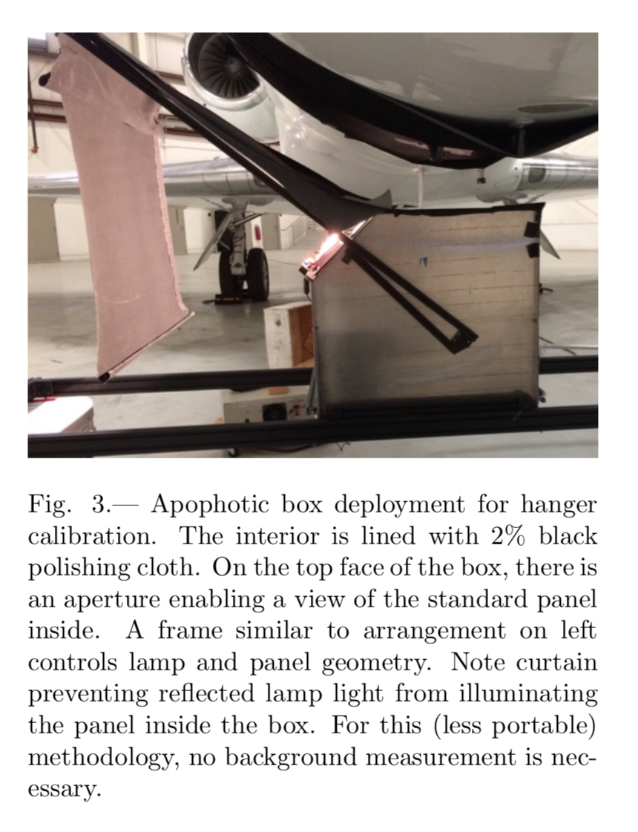
Estimate RCCs using a NIST-calibrated source
A dark laboratory, or special enclosure, prevents external light from entering.
Chapman et al., Remote Sensing (2019)

Slide 11
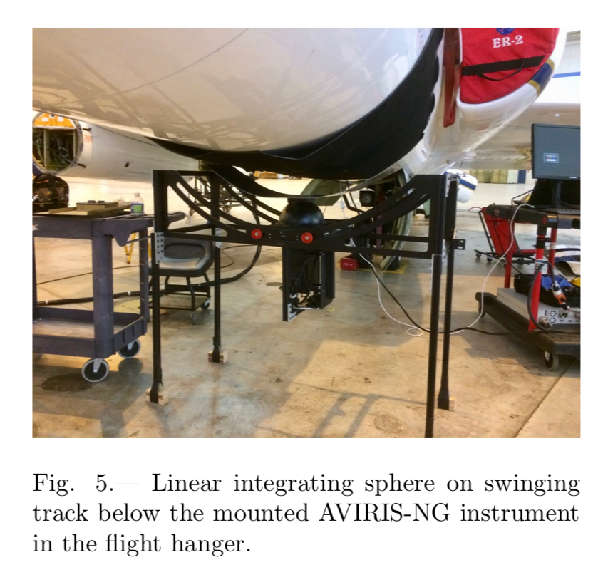
Flat field calibration equipment
Measuring the flat field response image requires a completely uniform illumination from a specially-designed calibration object. Each spectral channel’s response is scaled so that the flat field rows all average to unity.
Chapman et al., Remote Sensing (2019)

Slide 12
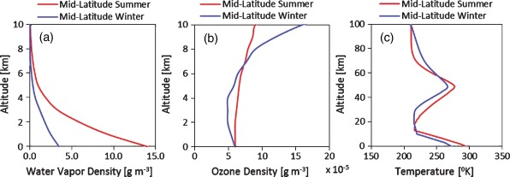
Validation method
We validate flight data by measuring a reflectance signature on the ground, and then converting it to radiance with a Radiative Transfer Model (RTM) that simulates photon propagation through the atmosphere.
RTM
scattering
absorption
images: Mishra et al., Heliyon 2015, wikimedia
reflection

Slide 13
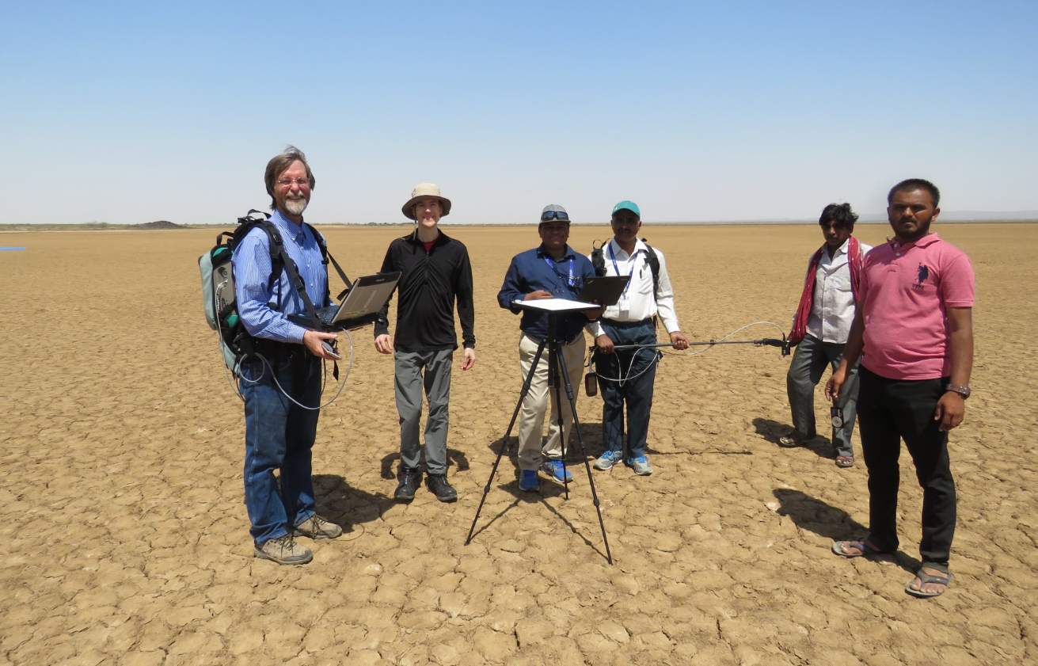
Validation
Field reflectance measurements are typically performed at an open playa site to limit scattered light from local vegetation or buildings. The surface should be uniform and flat, and imaged simultaneously with the overflight for similar solar geometry.
AVIRIS-NG remote measurement
AVIRIS-NG
Model from In-situ measurement
MODTRAN simulation
Desalpar Playa, India
Residual

Slide 15
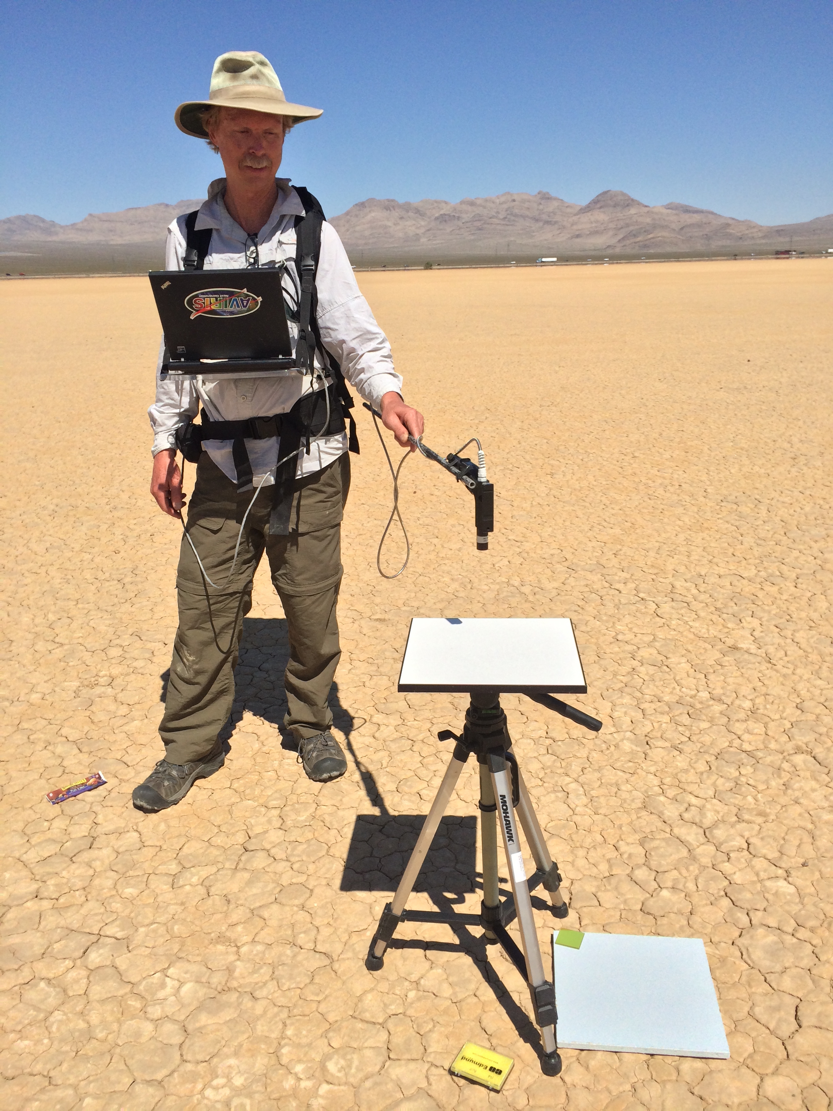
Exercise 7: Radiometric Calibration / Validation
Objective: Calibrate digital numbers and “close the loop” with predicted radiances from surface measurements acquired coincidently with an overflight of Ivanpah Playa, NM. Compare alternative Radiative Transfer Models (RTMs). Which is best? Files include:
predicted_radiance_atrem - a prediction of at-sensor radiance following Thompson et al., (RSE 2015).
predicted_radiance_modtran - via the MODTRAN RTM
flat - a flat field frame
rcc.txt - a file of radiometric calibration coefficients
dark - a dark current frame
dn - an imaging spectrometer file containing raw spectrometer data
loc - 3 bands, latitude, longitude, altitude, of the non-orthorectified FN file.
Reflectance was measured between two blue tarps placed on the playa surface, and used in the radiative transfer model. South tarp: 35.60285N, 115.40388W. North tarp: 35.60466, -115.40266

